Slide 1

Toronto Apartment Prices
by Bailey Duncan

Slide 2
Guiding Questions
Can we predict a Toronto apartment's rental price by knowing the businesses around it?
What makes one apartment more valuable than another with the same number of rooms?

Slide 3
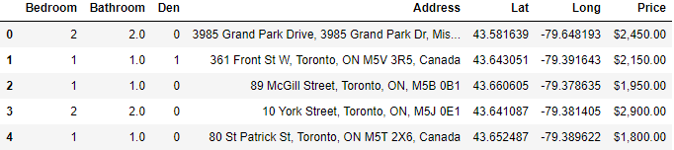
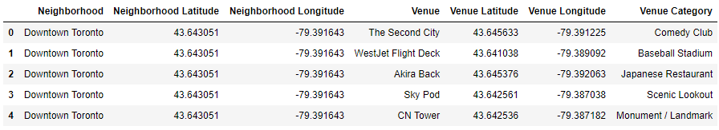
Data
Toronto Apartment Data from Kaggle:
Nearby Venues for each Apartment from FourSquare API

Slide 4
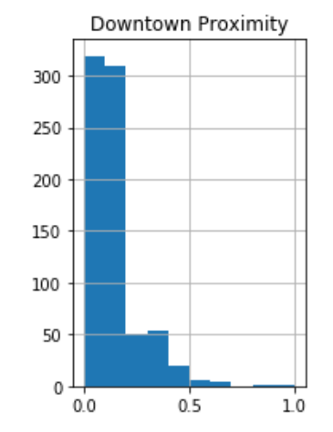
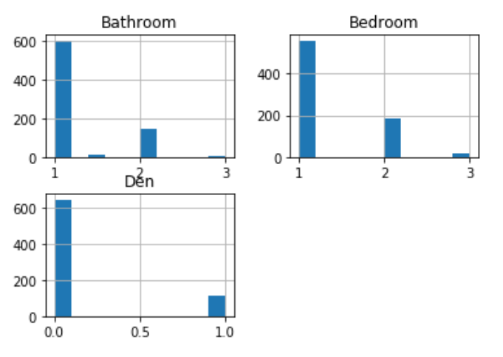
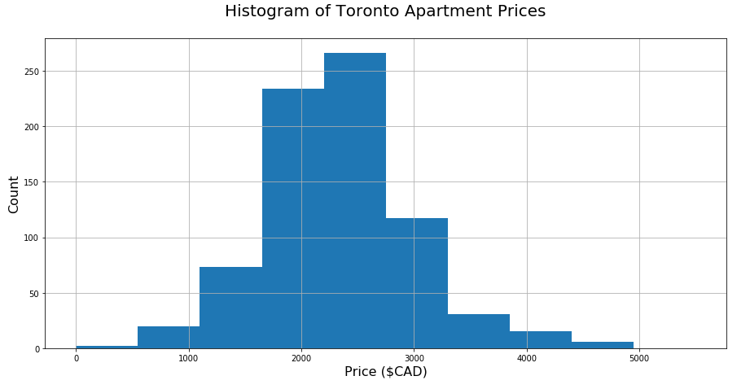
Exploring the Kaggle Data

Slide 5
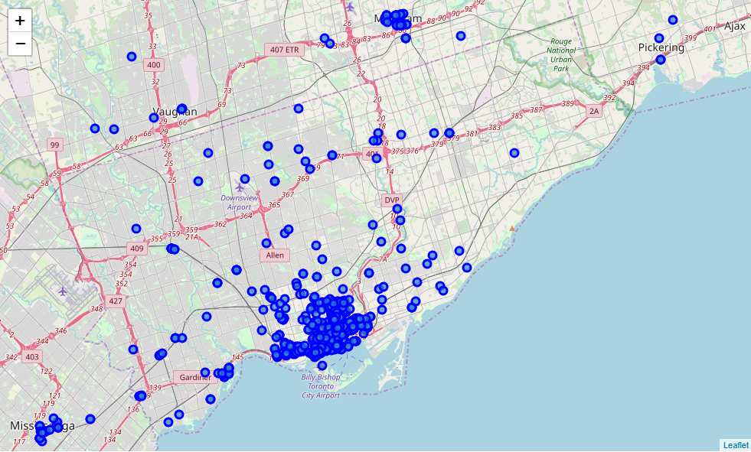

Slide 6
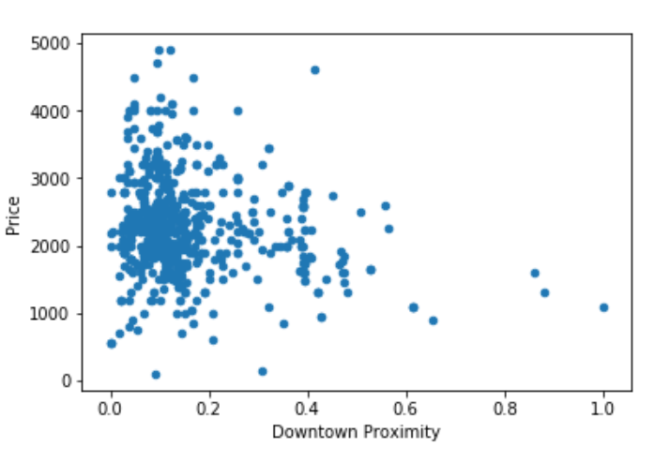
Downtown Proximity vs. Price
Looking for good indicators of apartment price
No linear trend we can see
Very hard to differentiate data points close to downtown

Slide 7
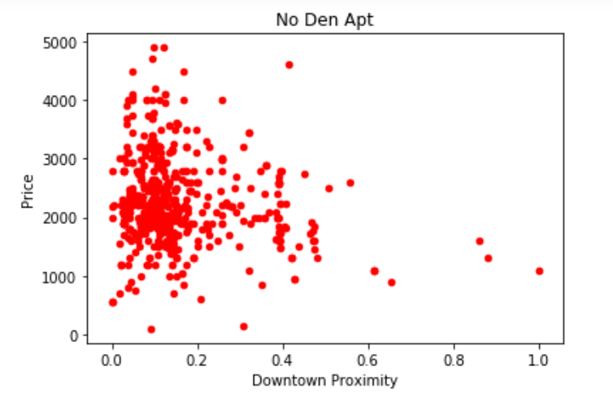
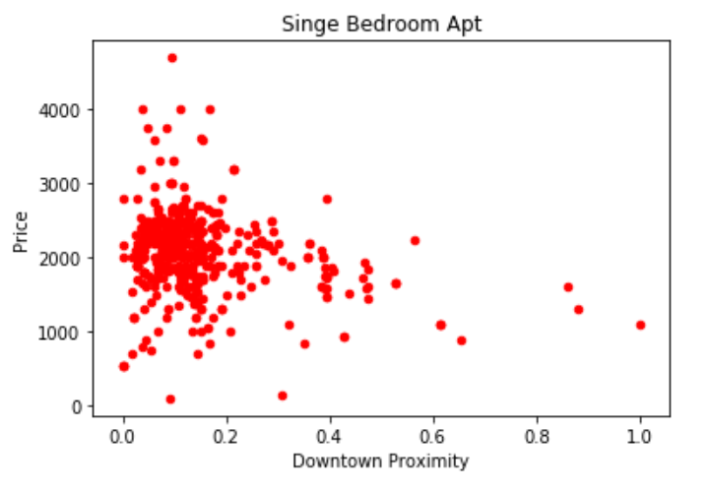
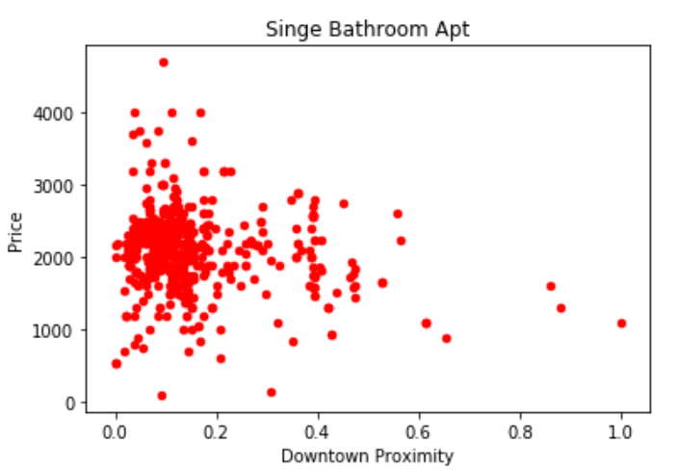
Introducing our Room Information
Even introducing the number of bathrooms, bedrooms, and dens doesn’t give a clear trend in downtown!
This means we will need to introduce additional data to predict the price of an apartment in downtown Toronto
We will use the nearby venues from the FourSquare API in addition to this data to try and predict the price

Slide 8


Benchmarking Machine Learning Models
Split the data into 3 sets: 60% Train, 20% Test, 20% Validation
We’ll feed the nearby businesses and apartment information into different models
Each regression model will be used with little hyperparameter tuning
They will be evaluated by comparing the Root Mean Square Error of the price prediction in Canadian Dollars ($CAD)

Slide 9
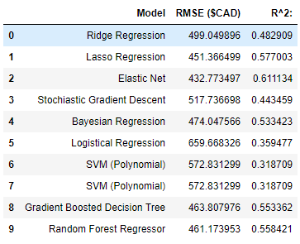
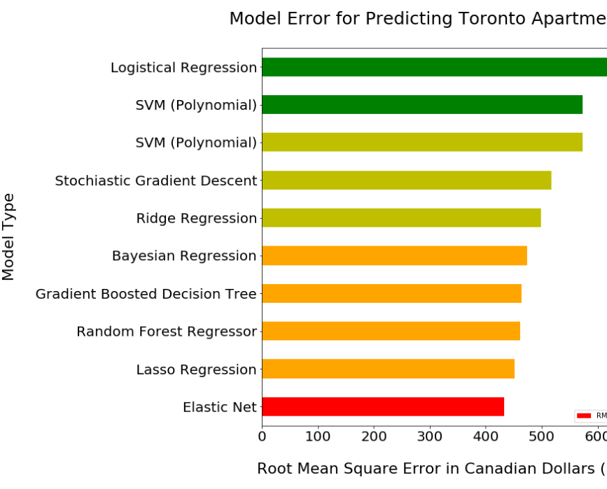
Initial Machine Learning Results
Elastic Net Model performs the best with the lowest error & highest correlation

Slide 10
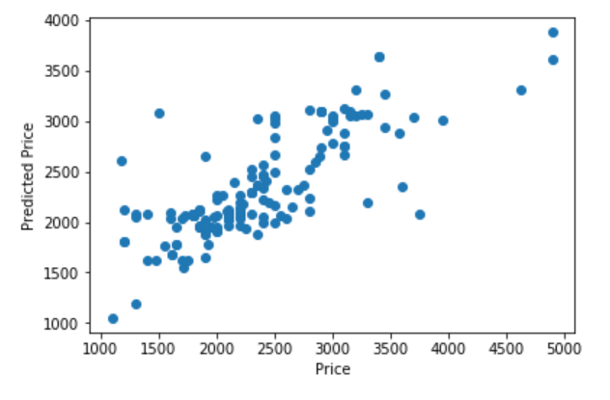
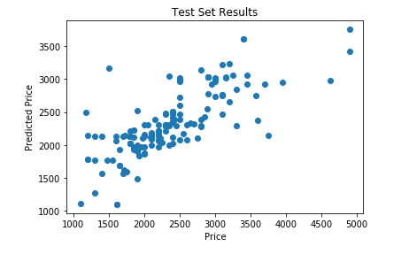
Tuned Model Performance
LEGEND
Perfect Prediction line
Model Prediction
Original Model Predictions
We tune the hyperparameters of the Elastic Net Model to perform better on the test set
After tuning we reduce its error on the test set predictions from $432 to $299.
$132 more accurate on average!
Tuned Model Predictions

Slide 11
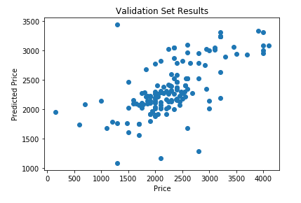
Validation Set Performance
Root Mean Square Error (RMSE): $341
Overall Accuracy: 74%
Test Set Accuracy was 86%

Slide 12
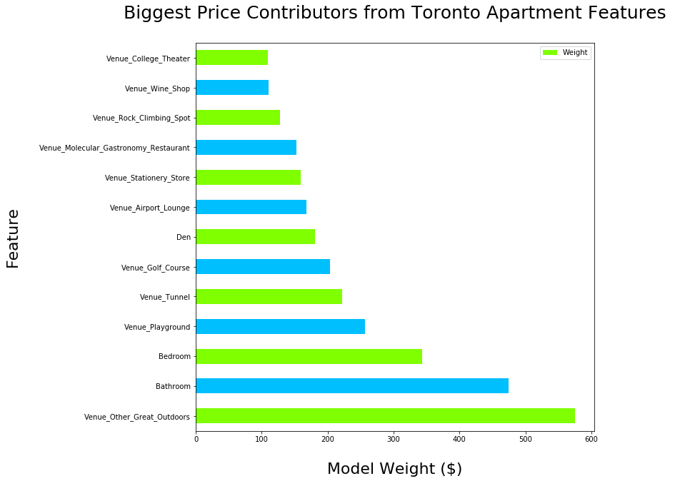
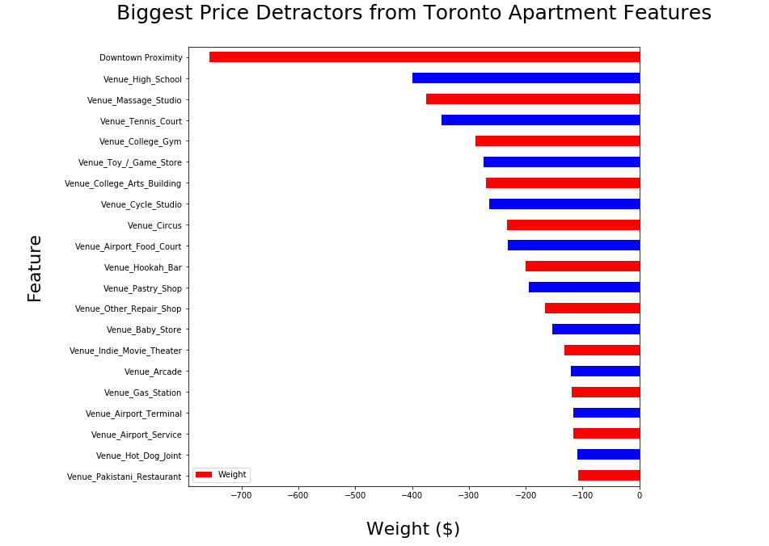
Extracting the Most Important Features
Pull out the most important features from the elastic net

Slide 13
Summary
More Expensive Apartments Have…
More Dens
More Bathrooms
More Bedrooms
Outdoors Activities Nearby: Parks, Golf, Playgrounds and Rock Climbing
Wine Stores
Cheaper Apartments Are…
Far from Downtown
Close to the Airport
High Schools, Toy Stores, Game Stores and Arcades Nearby
Hot Dog Stands
Massage Studios

Slide 14
Recommendations Based on Results
Apartment Complex Owners can drive prices higher, and make higher demand by investing in amenities in the neighborhood like:
Green space
Parks
Playgrounds
Outdoor activities
Apartment Tenants can find apartments with similar number of rooms but lower price point by looking:
further from downtown
closer to the airport
Close to high schools
At Apartments without nearby green space, and parks
Apartment Building Developers should develop in neighborhoods with:
Lots of parks, nature, outdoor activities
As close to downtown as possible, but not near the airport
The units will have the highest price when these conditions are met and they are not surrounded by car mechanics, hot dog stands, high schools, etc.

